Slide 1


Principles of Learning
IT&C210 S14

Slide 2

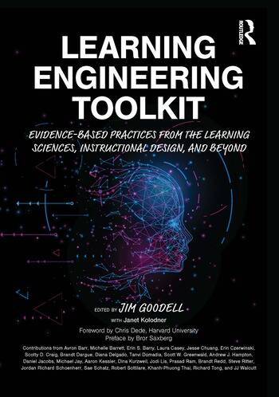
Learning Engineering is a process and interdisciplinary practice that applies the learning sciences using human-centered engineering design methodologies and data-informed decision making to support learners and their development.
https://sagroups.ieee.org/icicle
The International Consortium for Innovation and Collaboration in Learning Engineering
https://doi.org/10.4324/9781003276579

Slide 3
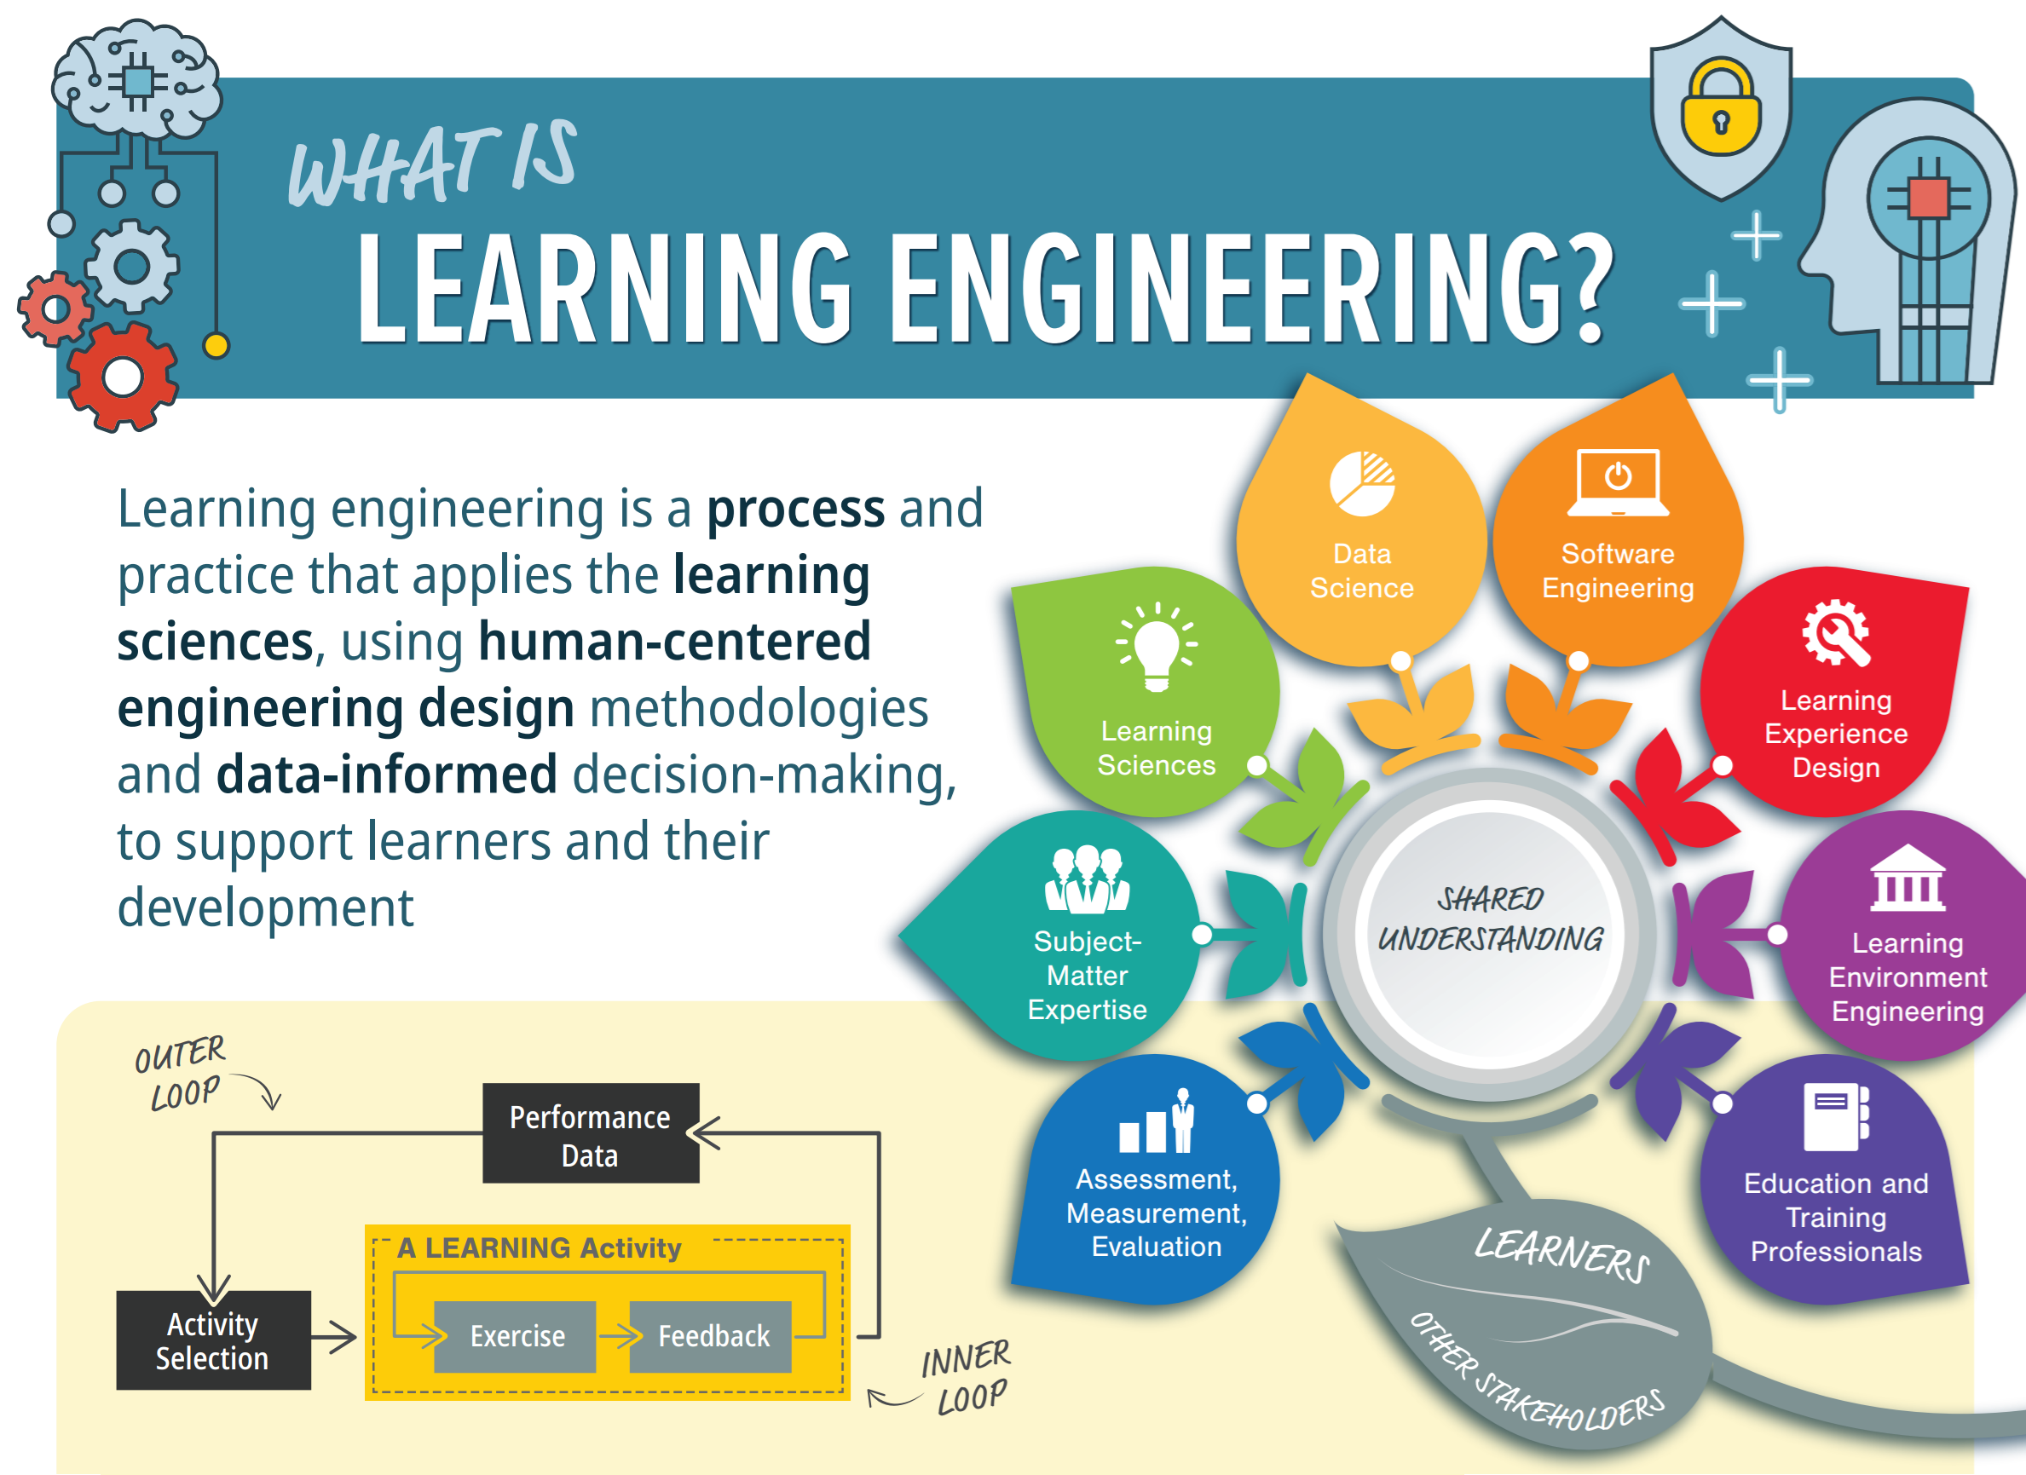

Slide 4
Things we know about how people learn.
Learning Capacity and Rate
Motivation
Bloom’s Two-Sigma Problem
Mastery Learning
Mindsets
The Flow Channel
School is a Game
Personalized and Competency-Based Learning

Slide 5
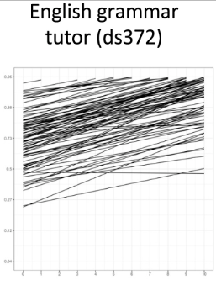
An Astonishing Regularity in Student Learning Rate - Kenneth Koedinger, Paulo Carvalho, Ran Liu, Elizabeth Mclaughlin
Analysis of 1.3 million observations across 27 data sets spanning elementary to college courses in math, science, and language.
Findings:
Very low variance in learning rate: Students need an average of 7-8 learning opportunities.
High variance in initial knowledge: Initial practice from 55% to 75% correct. Range of 13.13 and 3.66 learning opportunities required for mastery.
“Our evidence suggests that given favorable learning conditions for deliberate practice and given the learner invests effort in sufficient learning opportunities, indeed, anyone can learn anything they want.”
https://doi.org/10.1073/pnas.2221311120
Notes:
In the graph from the paper, each line represents one student. The slope of the line represents learning rate while the starting point of the line represents initial knowledge. That the lines are mostly parallel indicates remarkable similarity in learning rate.
Koedinger RQs
How may practice opportunities needed to reach mastery level of 80% correctness? (7)
How much do students vary in their initial performance?
How much to students vary in their learning rate?
Debate: Is the learning rate per practice opportunity variable or consistent across individuals?
Sought to identify differences in students’ self-regulated learning skills or background knowledge.
An astonishing amount of regularity in student learning rate:
Performance differences seem to come, not from differences in learning rate but differences in the number of quality learning opportunities.
Forms of “learning-by-doing”:
Mastery-based learning
Active learning
Testing effect
Formative assessment
Deliberate practice
Common features:
Provide immediate feedback on errors in problem solving or performance contexts
Provide explanatory context-specific instruction on demand, including a correct response if needed
Highly encourage or enforce students to enter or observe a correct response before moving on
Provide tailored tasks designed through data-based cognitive task analysis
Give repeated opportunities to ensure student mastery
Measured learning rate per opportunity to learn (slope) and initial knowledge (intercept)
Observations
Students start at about 65% correctness (following reading and lectures) and need about 7 practice repetitions to reach 80% correctness.
Students vary substantially in initial knowledge. (varying between 55% and 75% correctness on initial practice). This results in between 13.13 and 3.66 learning opportunities required for mastery. Thus, those with less initial knowledge require about 3 times as long to master a KU.
Students are Astonishingly Similar in Learning Rate
A typical “slow learner” requires only one additional learning opportunity to keep pace with a typical fast learner.
Domains: Language, math, science
Grade level: elementary, middle/high, college

Slide 6
Favorable Learning Conditions
Deliberate Practice
Depends on opportunity, and quality learning exercises
Lerner invests effort in sufficient learning opportunities
Depends on interest and dedication on the part of the learner

Slide 7

2. Motivation

Slide 8
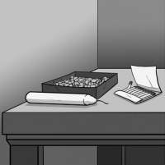
Motivation: Duncker’s Candle Problem
Notes:
Devised in the 1930s by Karl Duncker

Slide 9
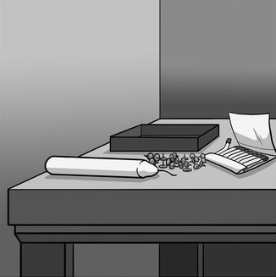
Candle Problem “for Dummies”
Notes:
Then Duncker tried a simplified problem.
Dan Pink calls this the “Candle Problem for Dummies”
In this case, the incentives worked as expected!
Converts the problem
from “hueristic” (trial, error, novel solution)
to “algorithmic” (simple set of steps)
Another way of saying this is that the original problem is a more cognitive task.

Slide 10
Candle Problem
7.41
11.08
Simpli- fied
3.67
4.99
Norm
Incentive
(Times in Minutes)
Subjects given financial incentives averaged 3.5 minutes slower on a cognitively demanding task!
(Glucksberg, Sam (1962) The influence of strength of drive on functional fixedness and perceptual recognition.)
Notes:
So, here are Glucksberg’s results:
The top row - original candle problem
Bottom row - simplified version.
For cognitively demanding task
financial incentives slowed them by 3½ minutes
or 33%!

Slide 11
Motivation: What we Know
Intrinsic Motivation is more powerful than extrinsic – especially with cognitively demanding tasks.
Learning is naturally rewarding and motivating, from a young child onward.
Extrinsic motivations, especially threatening ones, compromise the intrinsic rewards, converting an enjoyable activity into a chore.

Slide 12
What Motivates (from Drive by Dan Pink)
Autonomy
Mastery
Purpose

Slide 13
Distinctive Features of IT&C 210
IT210 so far
this term
Standard K-12
American education
Future classes
Ambiguous
Problems
Clear
Problems
Learn how to “approach” a problem (e.g., UML)
Learn to debug unexpected problems
Learn how to find answers
Learn the nature of the problem
Learn conceptual framework to work in
Learn what to search for
Notes:
We try to leave things ambiguous, but provide enough opportunities that TAs and instructor can help provide answers (after you’ve done some work to formulate them).

Slide 14
3. Bloom’s Two Sigma Problem

Slide 15
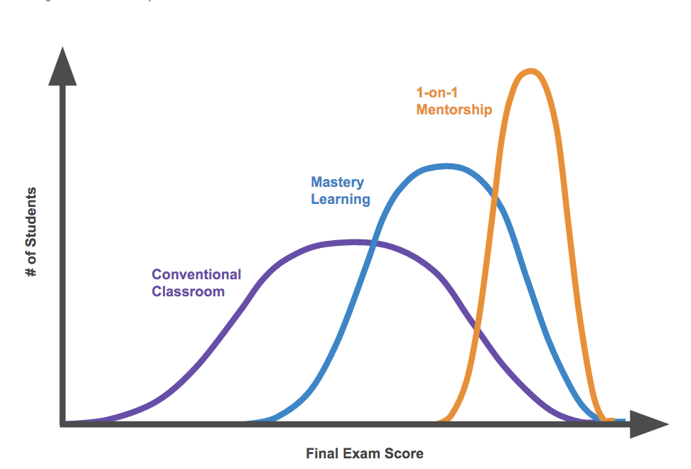
Bloom’s Two Sigma Problem
1984 Study: How fast can a student really learn?
Control Group: Conventional Classroom
Treatment Group 1: Mastery Learning
Treatment Group 2: Individual Tutors (Bloom’s grad students)
Tutored students learned 2 standard deviations more effectively.
Challenge: How to achieve equivalent results at scale?

Slide 16
Two-Sigma Revisited
2011 Meta Study by Kurt VanLehn (ASU) – published in Educational Psychologist
Compared conventional classroom instruction with AI tutors (Intelligent Tutoring Systems) and Human Tutors.
Computer and human tutors both yielded near 1-sigma improvement.
Found that the 2-sigma achievement by Bloom’s team includes a higher mastery threshold of 90%.
http://www.public.asu.edu/~kvanlehn/Stringent/PDF/EffectivenessOfTutoring_Vanlehn.pdf
https://www.ofthat.com/2013/01/blooms-two-sigma-problem-revisited.html
https://fullcircle.asu.edu/faculty/kurt-vanlehn-intelligent-tutoring-research-revolutionizes-teaching/
Notes:
http://www.public.asu.edu/~kvanlehn/Stringent/PDF/EffectivenessOfTutoring_Vanlehn.pdf

Slide 17
4. Mastery Learning

Slide 18
Mastery Learning
A Program of Learning where the student must achieve a level of mastery (e.g. 90% on a knowledge test) before advancing to learn subsequent skills or information.
Shifts a portion of responsibility for failure-to-learn from the student to the educational institution.
Requires individual learning programs and support for each student.

Slide 19
5. Mindsets

Slide 20
Growth Mindset
The belief that skill and ability can be increased through learning and practice.
Fixed Mindset
A belief that one’s capability is fixed or limited.
Neuroscience is squarely on the side of Growth. But the concept that Dr. Carol Dweck tested is whether one’s belief about their ability to improve intelligence would have an impact on their future performance. Studies show that it does.

Slide 21
Example Mindsets
Growth mindset: burning desire & confidence that you can develop and become who you want to become with hard work
Purpose & Relevance: belief that the things you are learning are valuable and relevant to you and your life and/or a larger purpose
Grit: Passion and perseverance. The ability to stick to a task until success is achieved.
Notes:
Angela Duckworth, a colleague of Carol Dweck’s, wrote the book on Grit.

Slide 22
6. The Flow Channel

Slide 23
Game Design
Notes:
How to achieve such effective teaching?

Slide 24
Flow Channel
Notes:
How to achieve such effective teaching?

Slide 25
Flow State (Mihaly Csikszentmihalyi)
Flow is when a person:
is engaged in a doable task
is able to focus
has a clear goal
receives immediate feedback
moves without worrying
has a sense of control
has suspended the sense of self and
has temporarily lost a sense of time.

Slide 26
Both Anxiety and Boredom result in Frustration which impairs learning.
Lev Vygotsky: Zone of Proximal Development
Mihaly Csikszentmihalyi: Flow: “A highly focused mental state conducive to productivity.
Jesse Schell: The Art of Game Design http://artofgamedesign.com/book/AGD%20-%20Chapter%2009.pdf)
Also see: http://www.ofthat.com/2012/12/game-design-and-zone-of-proximal.html
Notes:
How to achieve such effective teaching?

Slide 27
7. School is a Game

Slide 28

Definition of a Game
An activity that has:
A Goal
Rules
Feedback
Voluntary Participation
(Jane McGonigal, Reality is Broken)
School is a game, albeit one with some serious flaws in its rules.

Slide 29


Slide 30
Rules of School that Could Be Improved
Excessive consequence for failure to pass an exam or complete an assignment.
Rule is there because it’s costly to the institution to re-examine the student.
School-Pacing
School pacing incentivizes progress (extrinsically).
Individual pacing required for true Mastery Learning.
More resources would be required to track each student individually.
What rules have you encountered that don’t foster learning?

Slide 31
8. Personalized and Competency-Based Learning

Slide 32
Personalized Learning: Customizing the learning experience to the needs of each individual student. “Teaching students, not classes.”

Slide 33
Competency-Based Learning
Students are empowered daily to make important decisions about their learning experiences, how they will create and apply knowledge, and how they will demonstrate their learning.
Assessment is a meaningful, positive, and empowering learning experience for students that yields timely, relevant, and actionable evidence.
Students receive timely, differentiated support based on their individual learning needs.
Students progress based on evidence of mastery, not seat time.
Students learn actively using different pathways and varied pacing.
Strategies to ensure equity for all students are embedded in the culture, structure, and pedagogy of schools and education systems.
Rigorous, common expectations for learning (knowledge, skills, and dispositions) are explicit, transparent, measurable, and transferable.
Aurora Institute and CompetencyWorks: What is Competency-Based Education? An Updated Definition. November 2019 (https://aurora-institute.org/resource/what-is-competency-based-education-an-updated-definition/)

Slide 34
Personalized and Competency-Based Learning
Competency-Based Learning addresses some of the scaling issues of personalized learning by empowering students.
Much of the personalization responsibility is transferred to the students themselves.
The best students have always personalized the learning experience. In a way, this is just making personalization the expectation rather than the exception.

Slide 35
Study Questions
None of this will be on a quiz or exam. But considering these ideas should have a positive impact on your lifelong learning experience.
What is your reason for attending the university? Is it motivating to you? What mindsets might you adopt that would serve you better?
Which practices in IT&C 210 are consistent with Learning Science? Which are not? What about your other classes?
Identify a university education rule that impedes your learning. What purpose does it serve? How could it be improved? How could the rule’s original purpose be addressed differently?
What can you do to personalize the learning experience without requiring your classes to change?

